Slide 1
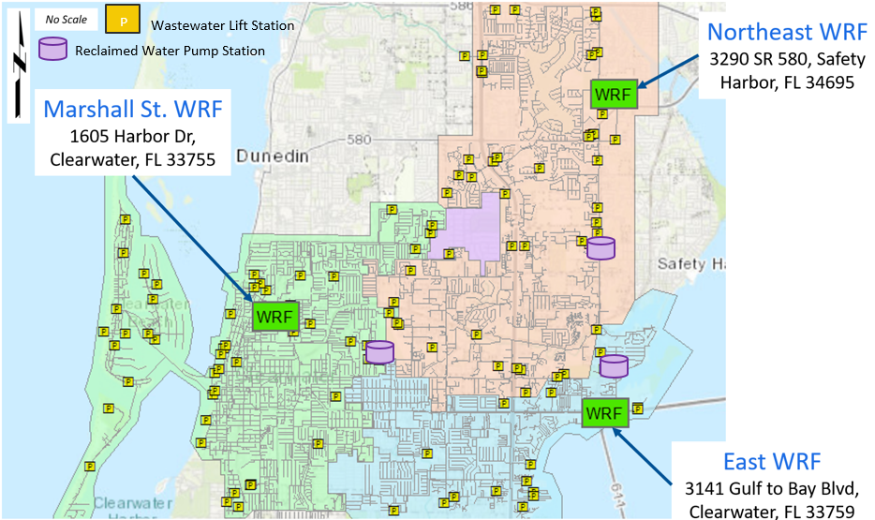
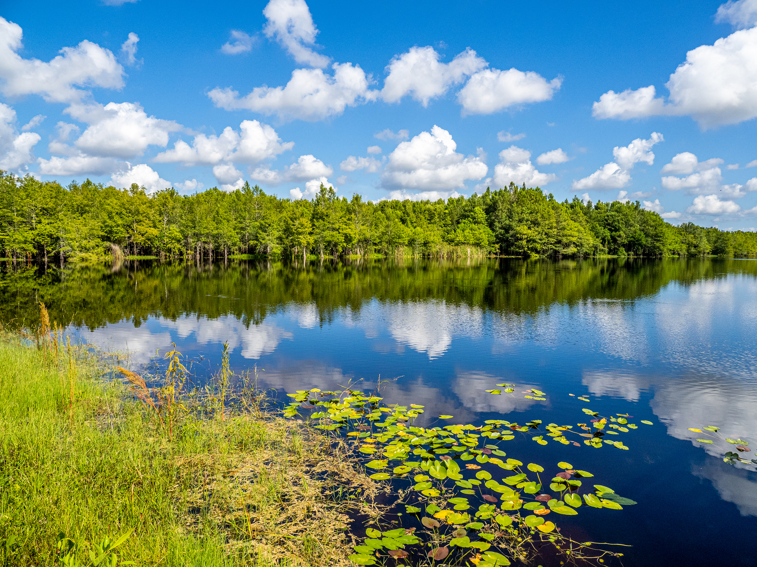
City of Clearwater | Clearwater WRF Master Plan
January 9, 2026
Purpose of the Master Plan
The City of Clearwater Public Utilities Department remains committed to the City's overall quality of life, health, and economy.
The City of Clearwater (City) owns and operates three water reclamation facilities (WRFs) to provide essential wastewater collection and treatment services to a significant portion of Pinellas County (County).
To address the growing population in the County and ensure continued high-quality service for both current and future customers, the City enlisted the services of Black & Veatch to complete a 30-year Master Plan and implementation strategy for the City’s three WRFs. While the WRFs have sufficient capacity to meet existing and future average daily flows and loadings, maximum and peak flows and loadings will require improvements before the 2050 planning horizon is completed.
This WRF Master Plan evaluates future strategies of the WRFs, the capacity of existing facilities, and alternatives that may be implemented to consolidate the facilities. The WRF Master Plan also proposes a Capital Improvement Plan (CIP) through 2050, identifying potential new projects to meet future demand.
P
Figure ES-1 City of Clearwater’s Water Reclamation Facilities, Services Areas, Lift Station, and Reclaimed Water Pump Stations
BLACK & VEATCH Ι Executive Summary
1

Slide 2
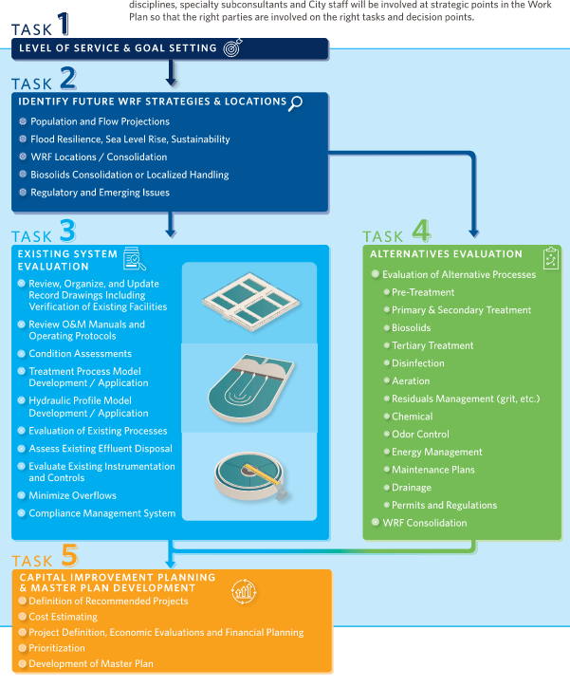
City of Clearwater | Clearwater WRF Master Plan
January 9, 2026
The Master Plan aids in determining current WRF renewal and replacement (R&R) needs and serves as a budgeting and planning roadmap for implementing future WRF modifications and improvements.
The Master Plan included the following Tasks:
BLACK & VEATCH Ι Executive Summary
2

Slide 3
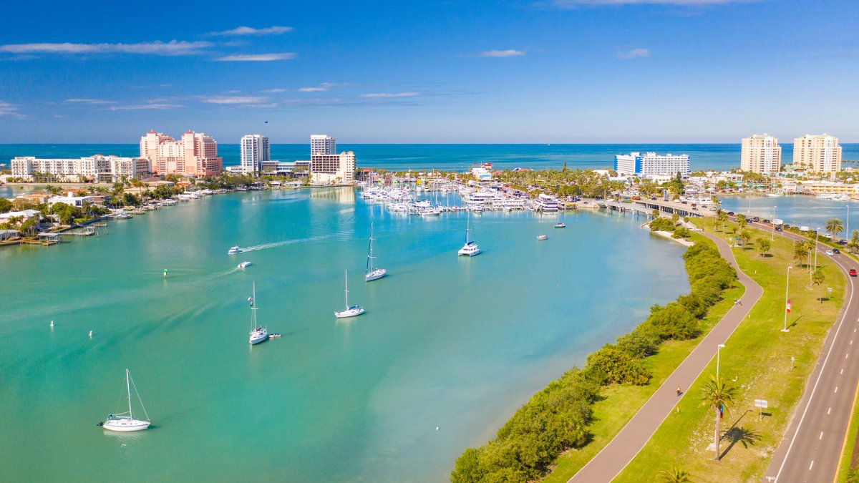
City of Clearwater | Clearwater WRF Master Plan
December 12, 2025
Level of Service and Goal Setting
The first step of the Master Plan was to set the level of service goals to be used to determine what the future system configuration would look like. The following categories were used for Level of Service of the WRFs and Goals of the Master Plan.
Service Reliability and Resiliency
Sustainability
Financial Responsibility
Safety
Quality
Operate and maintain infrastructure efficiently to provide a reliable and resilient service to customers.
Manage infrastructure to achieve the Clearwater Greenprint 2.0 sustainability goals and objectives to mitigate climate change impacts and improve resilience.
Ensure responsible financial management through optimization of expenditures.
Maintain and operate facilities to ensure employee, community, and public safety.
Produce treated effluent and recycled water that meet or exceed full compliance with regulatory requirements (current and upcoming).
BLACK & VEATCH Ι Executive Summary
3

Slide 4







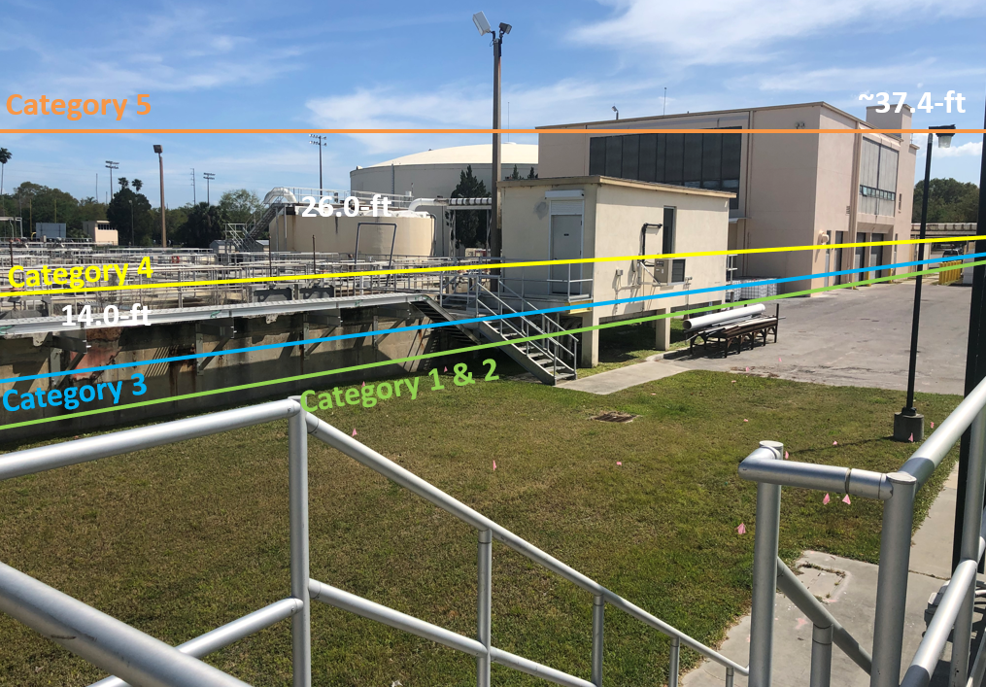
City of Clearwater | Clearwater WRF Master Plan
January 9, 2026
Future WRF Strategies
The Future WRF Strategies task focused on understanding the big picture needs of the three existing WRFs and assessing the impacts to the system from the following categories. The early decision, key to the rest of the Master Plan, ultimately revolved around defining the optimal configuration of the system(s). To consolidate or not to consolidate the three WRF? How to Consolidate?
Initial Assessments:
Growth / Flow Projections
High Level Condition Assessment / R&R Needs
Load Projections
Effluent Management Strategy Development
Regulatory Review
Biosolids Management Strategy Development
Climate Variability / Costal Hazards Vulnerability
Figure ES-2 Marshall Street WRF Predicted Storm Surge Levels
BLACK & VEATCH Ι Executive Summary
4

Slide 5
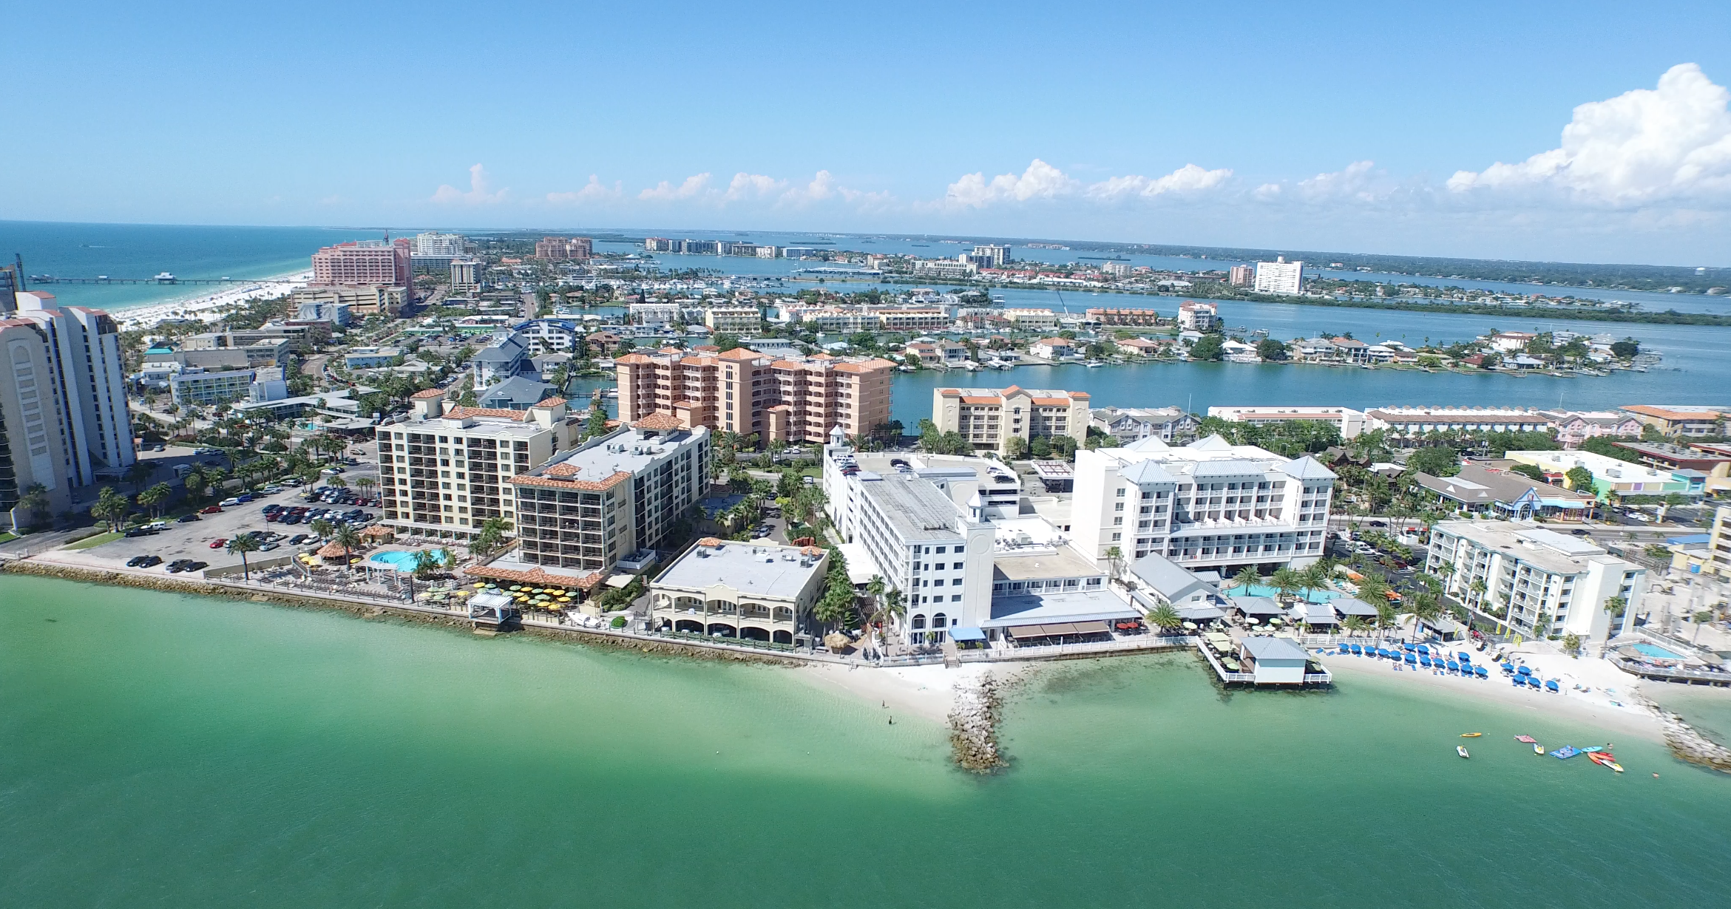

City of Clearwater | Clearwater WRF Master Plan
January 9, 2026
Consolidation Evaluation
After developing and evaluating six consolidation scenarios, the City’s Public Utilities Department and Black & Veatch scored each scenario using seven scoring criteria: System Reliability and Resilience; Maintenance Reliability and Resilience; Ease of Operations; Climate and Environmental Vulnerability; Sustainability; Financial Responsibility; and Public Perception. Scenario No. 2 – Consolidate Marshall Street WRF (MSWRF) and East WRF (EWRF) to Northeast WRF (NEWRF) was scored the highest and proceeded as the recommended consolidation scenario.
On March 3, 2023, City Council approved the complete consolidation of MSWRF and EWRF to NEWRF.
Key Decision
MSWRF+EWRF to New WRF
MSWRF+EWRF to NEWRF
All WRFs to New WRF
Existing Configuration
MSWRF to NEWRF
EWRF to NEWRF
Figure ES-3 Final Consolidation Evaluation Results
BLACK & VEATCH Ι Executive Summary
5

Slide 6








City of Clearwater | Clearwater WRF Master Plan
January 9, 2026
Existing System Evaluation
The Existing System Evaluation detailed the state of the existing facilities and processes at the NEWRF to identify issues that need to be addressed over the 30-year planning horizon, as well as to identify any limitations affecting each treatment unit’s ability to provide reliable long-term performance. To accomplish the evaluation, nine evaluations were conducted to assess the NEWRF.
Existing System Evaluations:
Detailed Condition Assessment
Treatment Model Evaluation
Building Assessment
I&C Evaluation
Record Drawing Review
Electrical Evaluation
O&M Manual Update
Energy and Chemical Use Baseline
Hydraulic and Pump System Evaluation
Figure ES-4 Remaining Useful Life of NEWRF Assets
While NEWRF generally is in fair condition, many of the assets are approaching the end of their remaining useful life. These results indicate a substantial amount of R&R will need to take place at NEWRF within the next 15 years and helped inform the formulation of CIP projects.
BLACK & VEATCH Ι Executive Summary
6

Slide 7
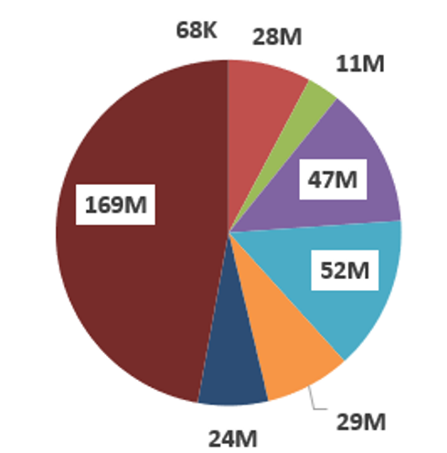
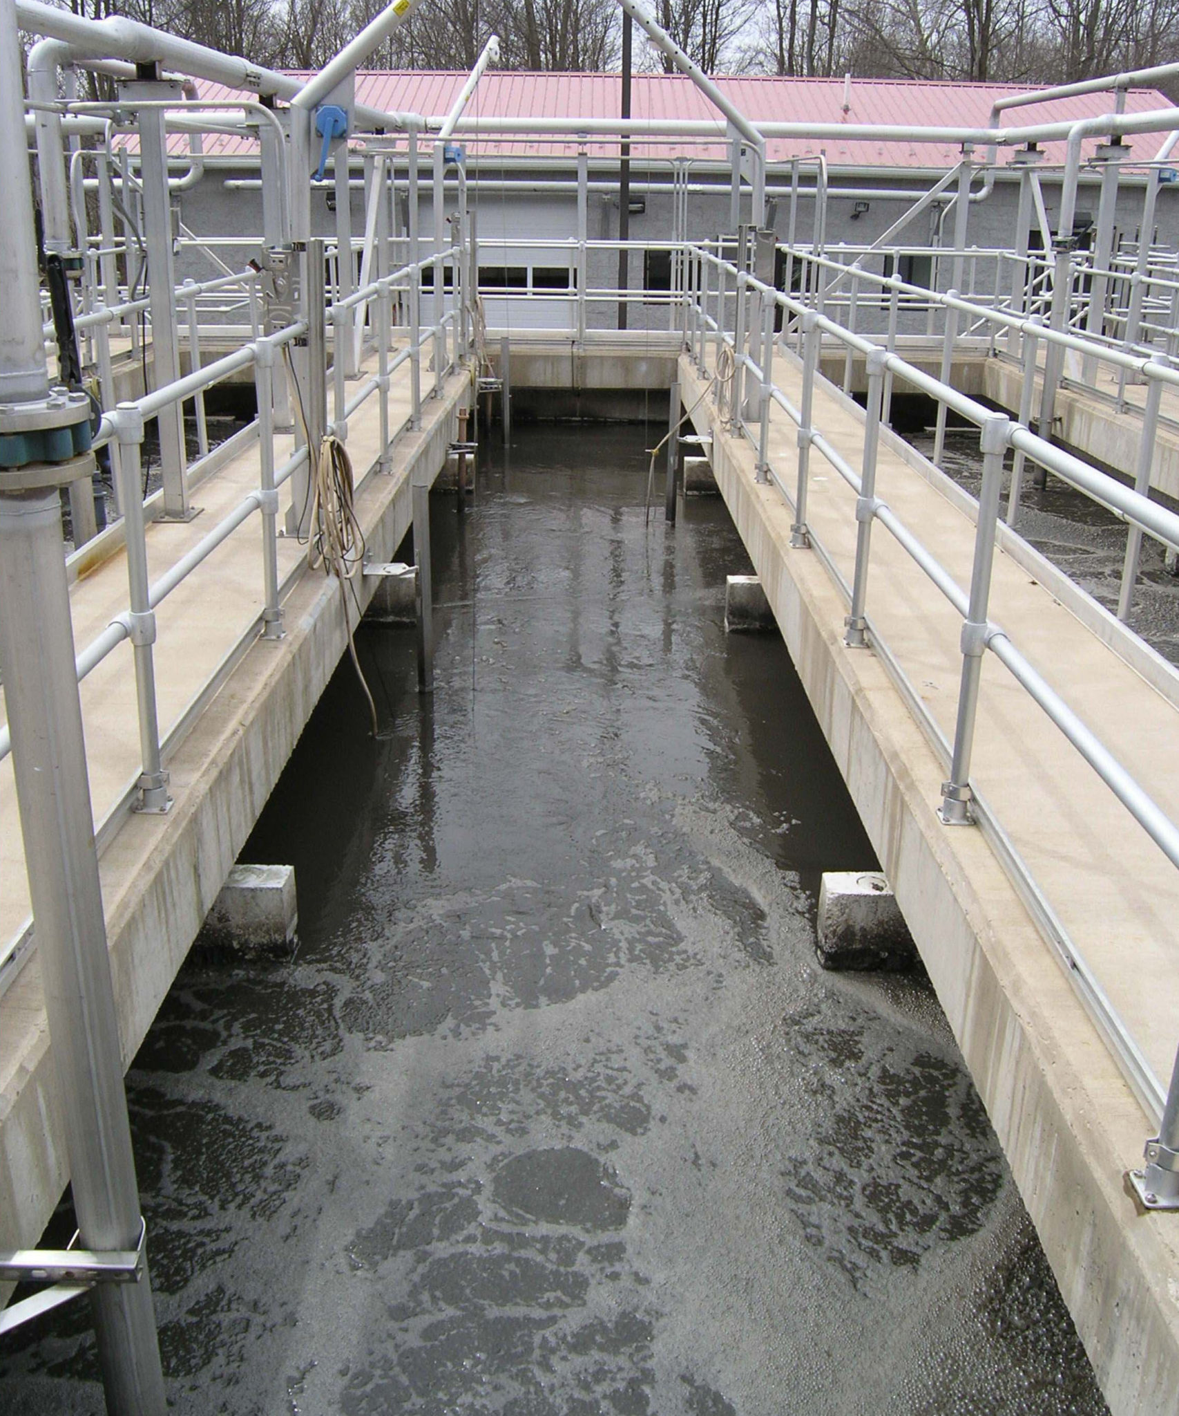
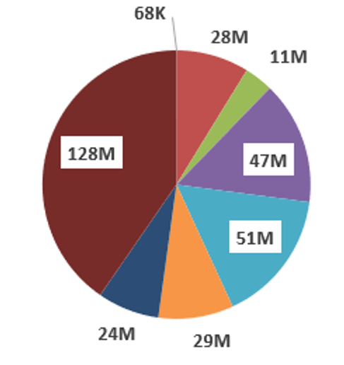
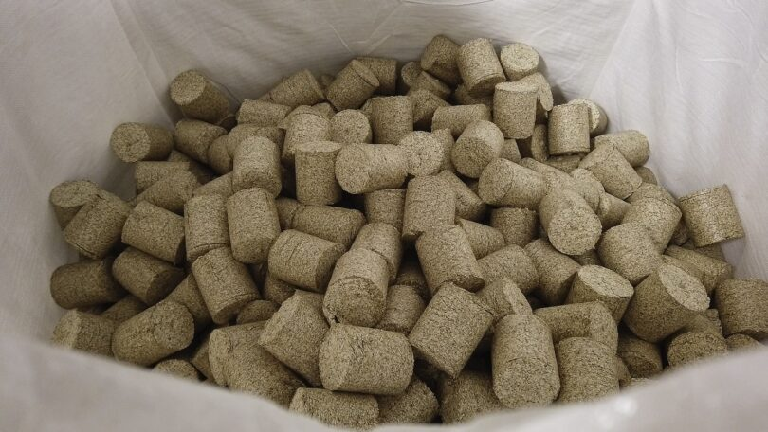
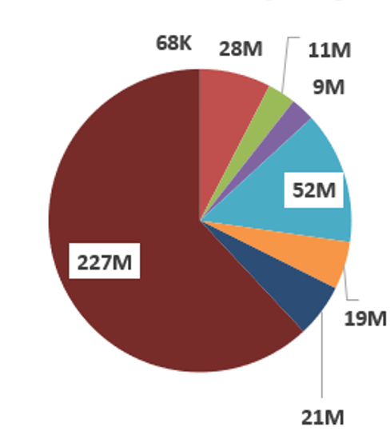
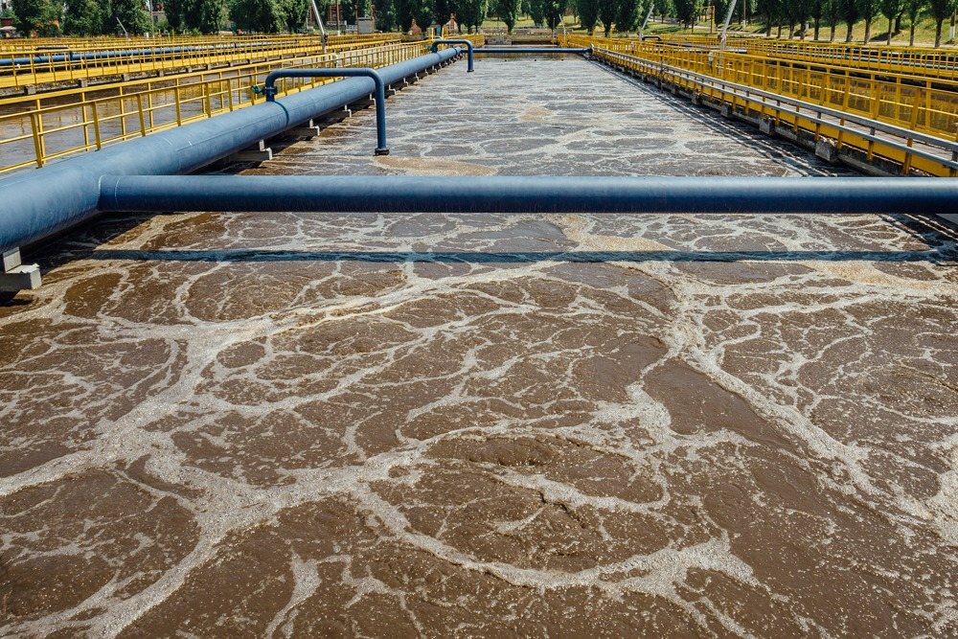
City of Clearwater | Clearwater WRF Master Plan
January 9, 2026
Alternatives Evaluation
A future process configuration evaluation was performed to determine if the treatment process at NEWRF should remain the same (5-stage Bardenpho process) or be modified to another treatment process to higher optimization. The unit processes for the three short-listed alternatives were evaluated to assess overall feasibility, identify required upgrades for implementation, and ensure alignment with the City’s level of service and goals.
Cost estimates were developed based on a holistic and comprehensive series of evaluations to identify the improvement needs for the three biological treatment expansion alternatives. The improvements are categorized into R&R and Expansion projects, and the budget costs for the through 2050 years are summarized below.
Alternative 1:
32 MGD Peak Flow
Base Case
(5-Stage Bardenpho)
Primary Treatment
Biological Treatment
Digestion
Chlorine Contact Basin
Dewatering
Headworks/Flow EQ
Tertiary Filtration
Expansion
Alternative 2:
32 MGD Peak Flow
Mobile Organic Biofilm (MOB) System (Nuvoda) Expansion
Alternative 3: 37.33 MGD Peak Flow
Base Case
(5-Stage Bardenpho)
Increased flows.
BLACK & VEATCH Ι Executive Summary
7

Slide 8
City of Clearwater | Clearwater WRF Master Plan
January 9, 2026
Alternative Scoring and Recommendations
The scoring criteria and weighting were first developed during Task 2 Future WRF Strategies to evaluate the City’s WRF system, including MSWRF, EWRF, and NEWRF. The criteria and weighting were then revised to align with the City’s decision to consolidate MSWRF and EWRF into NEWRF and expand NEWRF to accommodate the combined flow. Black & Veatch met with the City for the Alternative Scoring Results Workshop. During the workshop, participants scored the three alternatives based on the agreed upon criteria. Alternative 3 received the highest score of 2.48 overall, as well as in the categories of System Reliability and Resilience, Maintenance Reliability and Resilience, and Ease of Operations. Therefore, Alternative 3 is the recommended solution / treatment configuration for the future of the NEWRF.
Scoring Criteria | Weight | Alternative No. 1 - Base Case | Alternative No. 2 - MOB System (Nuvoda) | Alternative No. 3 - Base Case - 37.33 MGD Peak Flow
 |  | Score | Score | Score
System Reliability and Resilience | 20% | 2.39 | 1.79 | 2.95
Maintenance Reliability and Resilience | 20% | 2.62 | 1.21 | 2.77
Ease of Operations | 25% | 2.48 | 1.71 | 2.79
Sustainability (Greenprint 2.0) | 5% | 1.95 | 2.50 | 1.67
Financial Responsibility | 20% | 2.00 | 3.00 | 2.00
Public Perception | 5% | 1.80 | 1.93 | 1.45
Schedule | 5% | 2.20 | 1.57 | 1.70
TOTAL | 100% | 2.32 | 1.93 | 2.48
BLACK & VEATCH Ι Executive Summary
8

Slide 9
City of Clearwater | Clearwater WRF Master Plan
January 9, 2026
Capital Improvement Planning
A Capital Improvement Plan (CIP) was developed based on the recommended alternatives for expansion, repairs, future pipelines, and other improvements identified in this WRF Master Plan. By prioritizing these projects and investing in the necessary upgrades and repairs, the City is ensuring that it can meet the needs of its growing customer base, maintain customer level of service and increase the resiliency of its infrastructure for years to come.
Figure ES-5 Capital Improvement Plan Cash Flow
BLACK & VEATCH Ι Executive Summary
9

Slide 10
City of Clearwater | Clearwater WRF Master Plan
January 9, 2026
NEWRF Expansion Project - $227 Million in 2025 Dollars
R&R Projects: 2026 through 2030 - $70 Million in 2025 Dollars
Install new headworks building including four mechanically cleaned screens, grit removal, three AquaPrime Mega Disk Filters or other approved equivalent and a 5 MG flow equalization storage tank.
Install a new 5-Stage Bardenpho Treatment Train including: two fermentation basins, two first anoxic tanks, one oxidation ditch, two second anoxic tanks, and one reaeration tank.
Install two new secondary clarifiers.
Install an intermediate pump station to transfer flow from the existing and new secondary clarifiers to the new filter building.
Install three sodium hypochlorite storage tanks and relocate chemical building.
Add four pumps to the chlorine contact chambers.
Install one primary digester and install digester heating and mixing into existing secondary digester.
Install two centrifuges.
R&R Projects: 2036 through 2040 - $39 Million in 2025 Dollars
R&R Projects: 2041 through 2045 - $2 Million in 2025 Dollars
R&R Projects: 2046 through 2050 - $6 Million in 2025 Dollars
Dewatering/Solids Handling, FOG Removal, In-Plant Pump Stations, Digestion, Effluent, Generators & Fuel Storage, Maintenance Building, Primary Treatment, Secondary Treatment (Biological), Secondary Treatment (Clarifiers), and Tertiary Filtration
R&R Projects: 2031 through 2035 - $22 Million in 2025 Dollars
Blower Building, Secondary Treatment (Biological), Secondary Treatment (Clarifiers), Disinfection, Dewatering/Solids Handling, FOG Removal, Effluent, Digestion, and Generators & Fuel Storage
Blower Building, Secondary Treatment (Biological), Secondary Treatment (Clarifiers), Dewatering/Solids Handling, In-Plant Pump Stations, Generators & Fuel Storage, Maintenance Building, and Disinfection
Dewatering/Solids Handling, Digestion, and Generators & Fuel Storage
Blower Building, Secondary Treatment (Clarifiers), Dewatering/Solids Handling, Digestion, and Disinfection
Install three Aqua MegaDisk cloth media filters or other approved equivalent.
Install two 5 MGD reclaimed storage tanks.
BLACK & VEATCH Ι Executive Summary
10

Slide 11
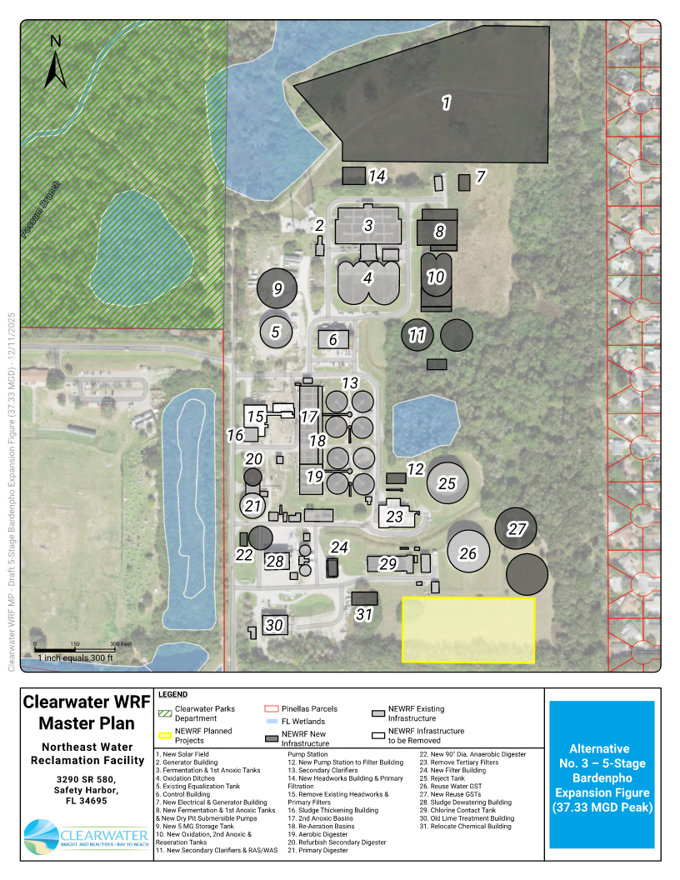
City of Clearwater | Clearwater WRF Master Plan
January 9, 2026
BLACK & VEATCH Ι Executive Summary
BLACK & VEATCH Ι Executive Summary
11
11

Slide 12
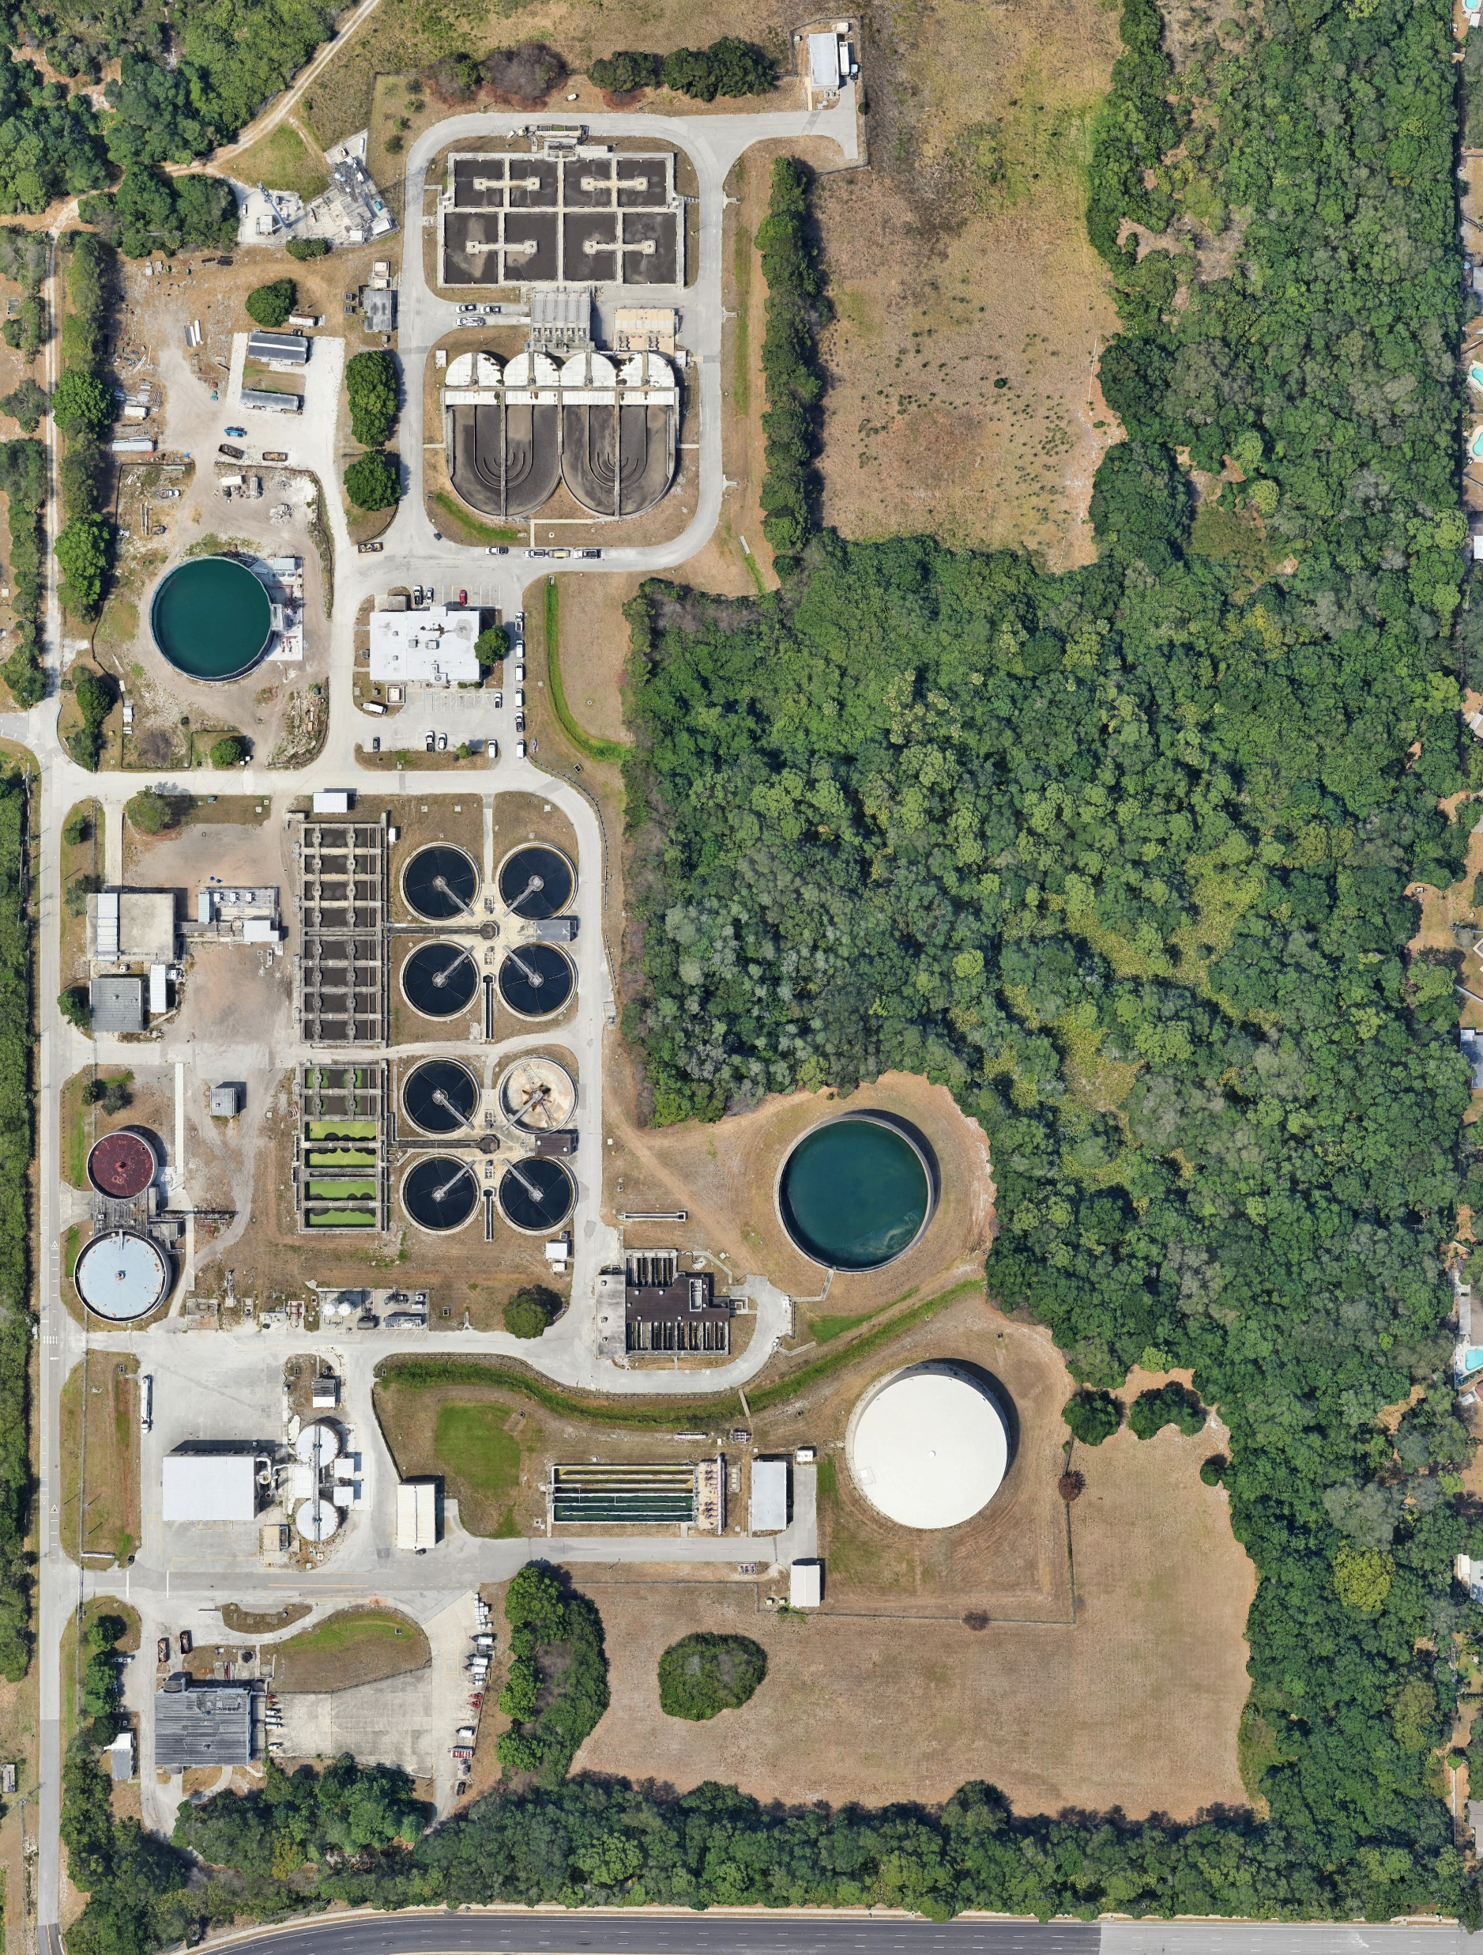

FINAL
WATER RECLAMATION
FACILITY MASTER PLAN
January 2026

